Slide 1
Project 1
Recipe Meal Planning App
Students:
Daiane Gomes
Blake Caraballo

Slide 2
Problems solution
The recipe meal prep app aims to streamline users' meal planning and cooking processes. Users can search and select recipes from a categorized database, considering their dietary preferences and cooking abilities. The app generates a consolidated grocery list based on selected recipes, helping users efficiently shop for ingredients.
Inputs:
User preferences (dietary restrictions, cuisine preferences).
Selected recipes for meal planning.
User-generated grocery list modifications.
Scheduled adding on calendar.
Outputs:
Planned meal schedules.
Consolidated grocery lists.
Instructions for meal preparation and grocery shopping list, cooking instructions and ingredient quantities

Slide 3
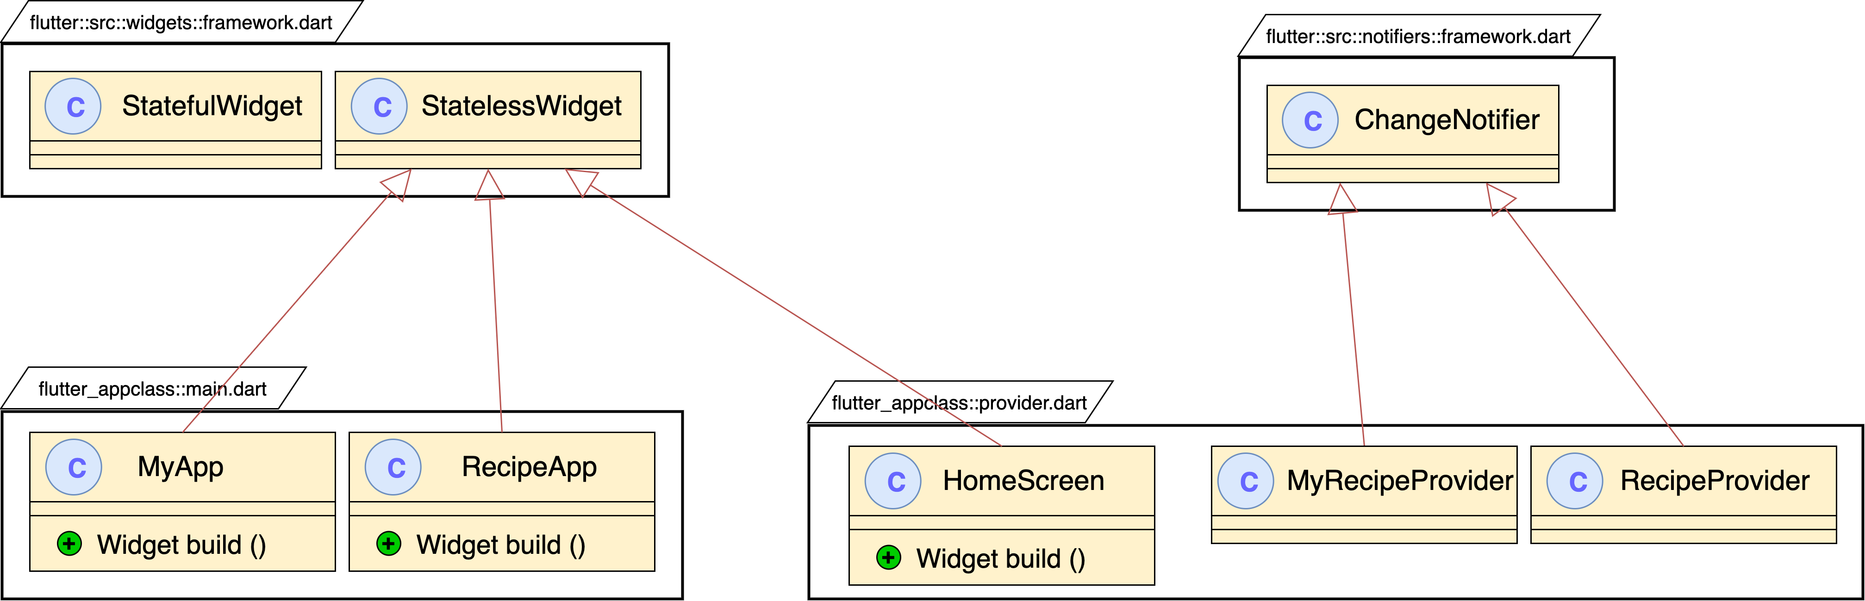
UML Class Diagram

Slide 4
Pseudo code
import 'package:flutter/material.dart';
import 'package:provider/provider.dart';
// Assuming these are your state management classes for handling recipes.
class MyRecipesProvider extends ChangeNotifier {
// Your provider's internal logic here
}
class RecipeProvider extends ChangeNotifier {
// Your provider's internal logic here
}
The code imports necessary packages for building a Flutter app: flutter/material.dart for UI components and provider/provider.dart for state management.
Two classes are defined: MyRecipesProvider and RecipeProvider, both extending ChangeNotifier. These classes are likely used for managing different aspects of recipe-related state within the app.
ChangeNotifier is a class provided by the Provider package that helps manage state and notifies listeners when the state changes.
These classes encapsulate the logic for handling recipe-related data and state changes, ensuring that the app's UI reflects the most up-to-date information.

Slide 5
Pseudo code
class HomeScreen extends StatelessWidget {
// Assuming the HomeScreen is a StatelessWidget for this example
const HomeScreen({Key? key}) : super(key: key);
@override
Widget build(BuildContext context) {
// HomeScreen UI code here
return Scaffold();
}
Defines a HomeScreen class that represents a screen in a Flutter app.
Inherits from the StatelessWidget class, indicating that it doesn't rely on mutable state.
Overrides the build method to define the UI of the screen.
Returns a Scaffold widget as the root of the screen's UI structure, providing basic layout functionality for the app.

Slide 6

Recipe App (DEMO)

Slide 7
Submission
Github Repository link :BlakeCaraballo/Recipe: Recipe App for Mobile App (github.com)
Icollege : Github Repository link and Youtube Link

